Slide 1
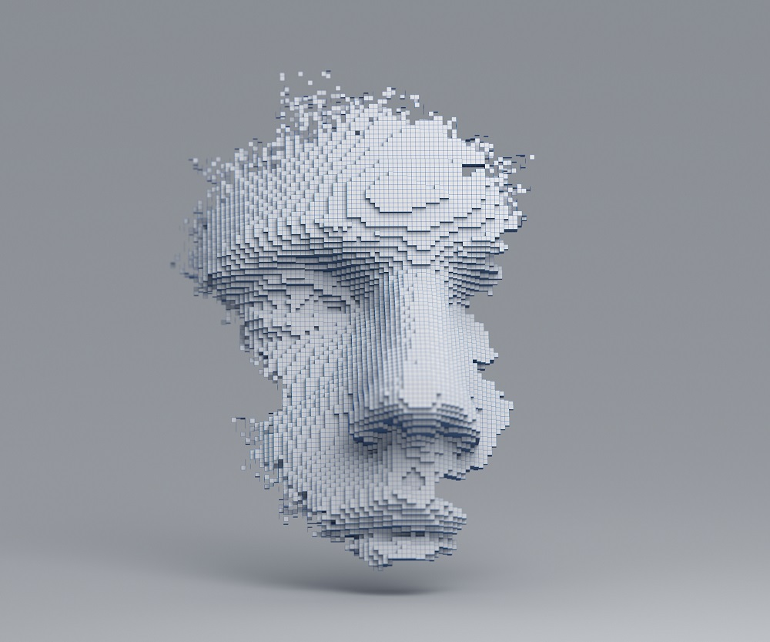
Philosophy of AI
CSc48800
Fall 2021
Prof Hunter
Ismail Akram
Dante Betancourt
Grismely Hiraldo
Alice Maharjan
Yasiris Ortiz
Azwad Shameem
Tenzin Tashi
Notes:
Speaker: Ismail
Hello, we’re group 5 which consist of (names) and we’re presenting “Philosophy of AI”.

Slide 2
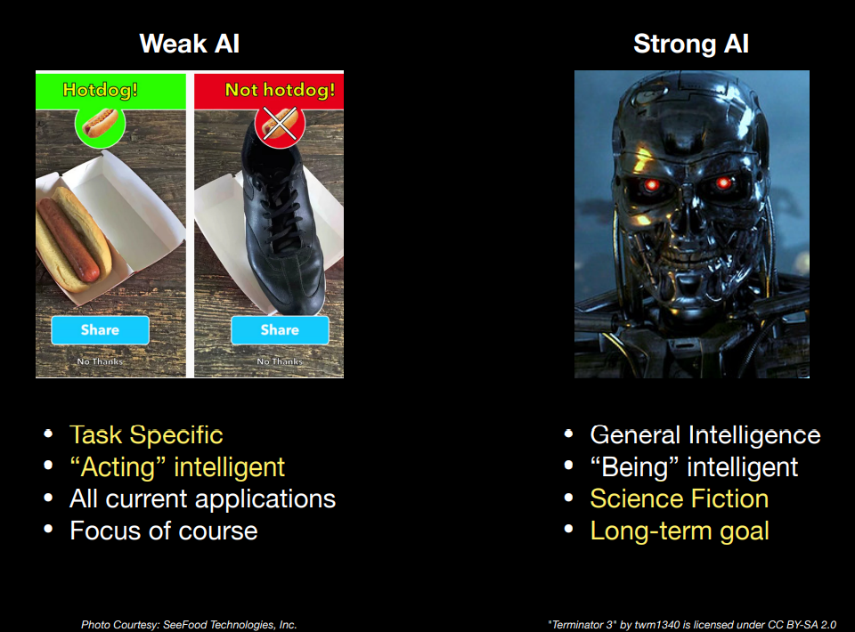
Recap primer: Weak AI vs Strong AI
Intelligence: able to learn and understand things.
Artificial Intelligence: machines/systems mirroring intelligence through their thoughts and actions.
Weak AI: tooled to a specific autonomous task.
Limited by program.
Strong AI: theoretical system to perform any “intelligent task”.
Indistinguishable from the human mind.
Assume theoretical assumption is actualized!
Now let’s explore the philosophical and ethical implications.
Lecture 1: What is AI?
Notes:
Speaker: Ismail
Before we formally start our presentation, we need to recap some key terms:
Recall that we defined intelligence simply as “able to learn and understand things”.
And also recall that we defined Artificial Intelligence as “machine/systems mirroring intelligence through their thoughts and actions”.
In the beginning of our course we made a distinction between weak AI and strong AI.
Throughout our course, we focused primarily on task-specific weak AI which is merely “acting” intelligent for a designated task.
Strong AI, however, is a theoretical system to perform any “intelligent task”.
For our presentation, we’re realizing that theoretical assumption as a thought experiment - “what if strong AI were to be actualized” - so we can discuss the philosophical and ethical implications.
Source:
Lecture 1 Slides
https://www.merriam-webster.com/dictionary/intelligent

Slide 3
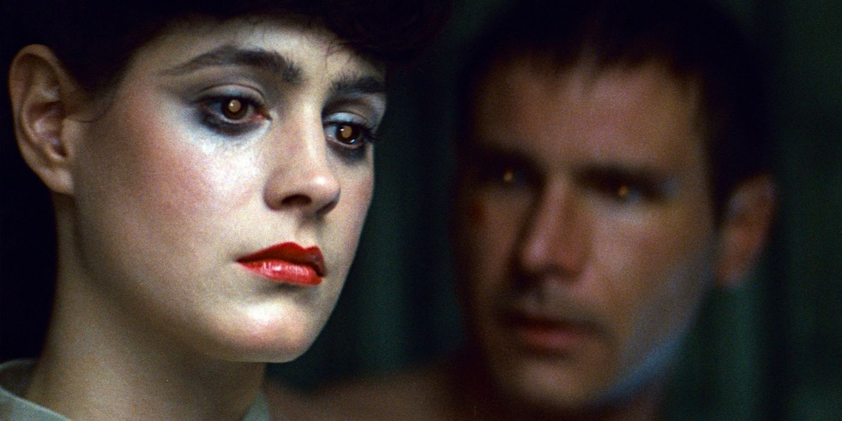
Thought experiment: Weak vs Strong AI
Strong AI actualization means the loss of our unique human standing as intelligent beings.
Competition/coexistence with another intelligent being.
Backbone of sci-fi fiction:
Do Androids Dream of Electric Sheep? (Philip K Dick)
Blade Runner (Ridley Scott)
Blade Runner 2049 (Denis Villeneuve)
Sprawl Trilogy (William Gibson)
Ghost in the Shell (Masamune Shirow, Mamoru Oshii)
Dune (Frank Herbert, Denis Villeneuve)
AI banned, “triumph of the human will”
Mind-Body Dualism: consciousness is ontologically distinct from the physical.
Epistemology: nature of knowledge (re: limits and validity).
Blade Runner (1982)
Notes:
Speaker: Ismail
If we truly do create a strong AI system that is as "intelligent" as a human being then our unique status as intelligent beings ceases to exist.
We would then be sharing our world and society with another type of intelligent being. This idea is the inspiration behind a myriad of science-fiction media.
Interestingly, the topics explored in these sci-fi media parallel our own contemporary problems:
We have literary works like:
Do Androids Dream of Electric Sheep? (Philip K Dick) - that explore class division, racism & climate change in a dystopian future.
Blade Runner (Ridley Scott) … we have the respective films adaptations
Blade Runner 2049 ( Denis Villeneuve) … the latter which explores reproductive repercussions of sentient AI - “Replicants” in a distant dystopia
Sprawl Trilogy (William Gibson) - Cyberpunk genre
Ghost in the Shell (Masamune Shirow) - explores existential dread but ultimately boasts a harmonious relationship with AI
Which is derived from Gilbert Ryle’s “Ghost in the Machine” Essay
Which is derived from Descartes Mind-Body Dualism - dualism: the claim that consciousness is ontologically distinct from anything physical.
Which parallels to Epistemology from Deliverance from Error - Abu Hamid Al-Ghazali
Epistemology: the study or a theory of the nature and grounds of knowledge especially with reference to its limits and validity
It’s worthwhile to mention that in the world of Dune (Frank Herbert , Denis Villeneuve) … AI is banned, since it’s touted as the “triumph of the human will”
Sources:
https://iep.utm.edu/dualism/
https://www.merriam-webster.com/dictionary/epistemology
https://medium.com/@mustaphahitani/abu-hamid-al-ghazalis-influence-on-ren%C3%A9-descartes-d9e6bb4fb29

Slide 4
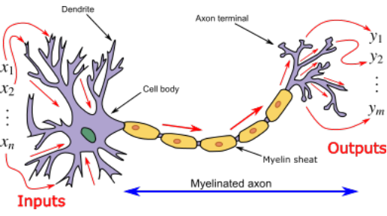
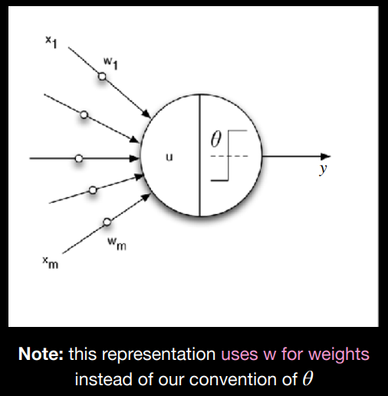
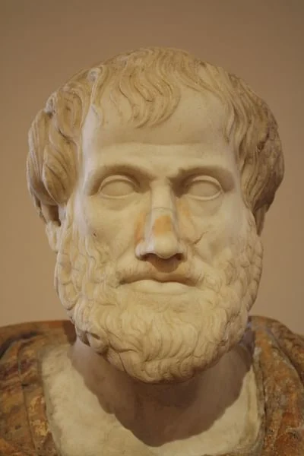
Introduction: Artificial and Human Intelligence
The perceptron is not 1:1 to the neuron; ontologically.
Ontological: “nature of being”.
Our model for AI is grounded in the realm of naturalism.
Naturalism interprets philosophy through the methods of the empirical sciences
without a priori project of theorizing.
Transcendent: beyond the range of normal/physical human experience.
(of God) existing apart from and not subject to the limitations of the material universe.
Metacognition: awareness/understanding of one’s own thoughts.
To actualize Strong AI means to assume AI singularity:
Perceptron = Neuron on a 1:1 basis & AI has metacognition.
Neurons ‘fire’ an electrical signal to outputs in certain conditions.
Perceptron: mathematical model INSPIRED by a neuron (Frank Rosenblatt 1958)
Lecture 11: Deep Learning pt. 1
Notes:
Speaker: Ismail
So, why is this thought experiment restricted to the theoretical realm?
AI is not a transcendent innovation despite its almost mystical overcoming of the world.
The technology behind AI is inherently unspiritual since it’s based upon a naturalistic conception of the human psyche.
Naturalism is an approach to philosophical problems that interprets them as tractable (understandable) through the methods of the empirical sciences or at least, without a distinctively a priori project of theorizing.
AI neural networks are quite literally ‘inspired by the biological networks that constitute animal brains’
- the type of intelligence simulated by AI is that of Aristotle’s animal or ‘sensitive soul’
- which is physical and mental, not in the higher ‘rational soul’ or “ratio”- the type of rationality unique to humans. A really good example of this is metacognition: which is awareness of one’s own thoughts. (BRIDGE to Hard Problem of Consciousness).
Sources:
Lecture 11 Slides
https://iep.utm.edu/art-inte/
https://iep.utm.edu/naturali/
https://iep.utm.edu/mat-comp/
https://twitter.com/EsmeLKPartridge/status/1451923745518592004 - Esmé Partridge, Spiritually in the Postmodern World - in response to BBC’s “God and robots: Will AI transform religion?”

Slide 5

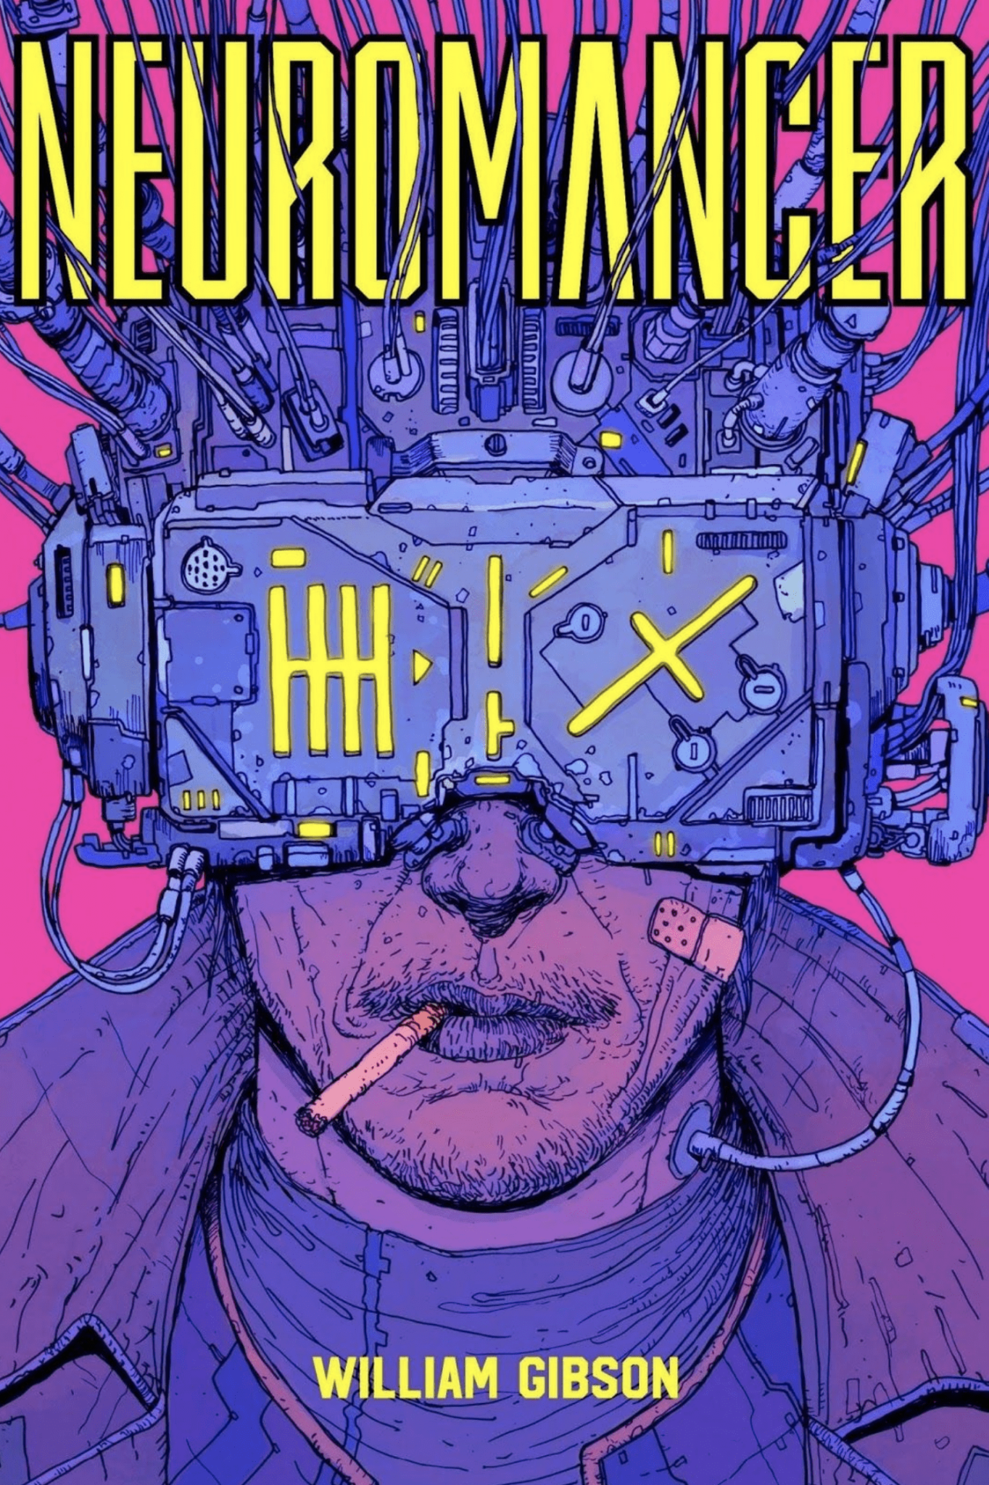
Losing our unique standing as intelligent beings:
Hard Problem of consciousness
Hard Problem of Consciousness: problem of explaining why any physical state is conscience rather than nonconscious.
why and how we have phenomenal experiences
unbridgeable explanatory gap between physical and immaterial.
Phenomenal consciousness: “what the experience is like for the subject”.
Physicalism: consisting of just the basic elements of physics plus structural, dynamical, and functional combinations of those basic elements.
Why is it a HARD problem (especially for AI)?
We cannot define consciousness using a Naturalistic foundation, since consciousness transcends it.
Artificial Intelligence is based upon a Naturalistic foundation.
Notes:
Speaker: Grismely
The hard problem of of consciousness is described as the philosophical problem of explaining why any physical state is conscience rather than nonconscious--it is the question of why and how we have phenomenal experiences
Phenomenal referring to what an experience is like for a subject.
The problem of consciousness is explicitly HARD problem and not an easy one because it goes beyond the usual methods of science.
Even if we describe the functional, dynamic, and structural properties of the conscious mind (through Neuroscience), we can still meaningfully ask - “Why is it conscious?” Consciousness therefore presents a hard problem for science.
Now why we ask ourselves why is this a hard problem for AI?
With a naturalistic frame of thought (which is what AI is based on), we can't have true self-sentient AI.
If we do not have a finite definition of consciousness or intelligence then we cannot replicate or reproduce it.
Sources:
https://iep.utm.edu/hard-con/
https://iep.utm.edu/dualism/

Slide 6
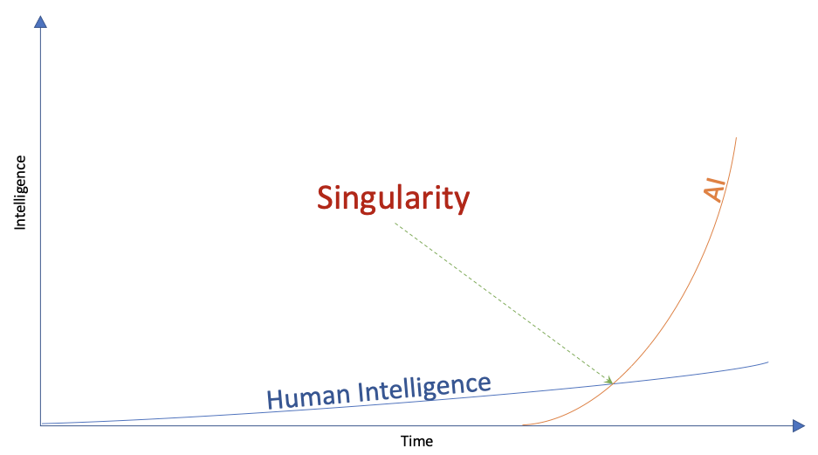

Sharing our existence with other intelligent beings:
Competition
Technological singularity: hypothetical point in time where technological growth becomes uncontrollable and irreversible
Result: unforeseen changes in human civilization (cyberization?)
Creative Destruction (Schumpeter): free market’s evolutionary progress via destruction of old jobs.
in the context of AI: Jobs become siphoned by AI, and ultimately do away with human involvement.
Social Engineering (Postman):
algorithmic control of the internet/social media feeds
feedback loops reinforce echo chambers
time spent on our devices result in sedentary habits
Cyber Warfare: information control and automated warfare can stimulate war economies. Evolution of war.
Strong AI would bolster these already pervading problems but with rapid evolution and “self awareness”.
“People will come to adore the technologies that undo their capacities to think” - Amusing Ourselves to Death by Neil Postman
AI singularity: point at which AI has “become” self aware.
Notes:
Speaker: Grismely
We’ve discussed consciousness and how it goes beyond the limits of science this inherently makes us unique, the possibility of reproducing it in any capacity will result in competition
Some ways this can occur is a
Technological singularity
Which is a turning point in which technological growth is irreversible,
Perhaps it would be a far more potent change akin to the Industrial Revolution, globalization, and the birth of the internet.
The most notable example is an AI singularity; a point at which AI has “become” self aware.
Other examples are of this competition that can arise is Creative Destruction; the free market progress of destroying and a replacing an industry.
A Weak AI could eventually replace most current jobs, so a Strong AI would greatly rid the need for human involvement altogether.
Lastly we have cyberware, a competition greatly dreaded and feared.
Strong AI could engage in Cyber Warfare via control of information and even automated warfare. A more specific example: botting.
We are not yet equipped to prevent the cybercrimes and cyber warfare from extreme digitalization
Susceptible to havok created by hackers
The internet is still new to us from an evolutionary standpoint, whereas a Strong AI can evolve at a much more rapid pace.
These are examples of competition with Strong AI, and now onwards to Coexistence: (BRIDGE)
Sources:
https://en.wikipedia.org/wiki/Technological_singularity
https://towardsdatascience.com/singularity-may-not-require-agi-3fae8378b2
https://www.econlib.org/library/Enc/CreativeDestruction.html Creative Destruction - Joseph Schumpeter
https://emorywheel.com/humans-arent-ready-to-coexist-with-ai/
https://www.fastcompany.com/90272087/elon-musk-says-hell-turn-you-into-a-cyborg-in-the-next-decade
https://www.amazon.com/Amusing-Ourselves-Death-Discourse-Business/dp/014303653X Amusing Ourselves to Death by Neil Postman

Slide 7
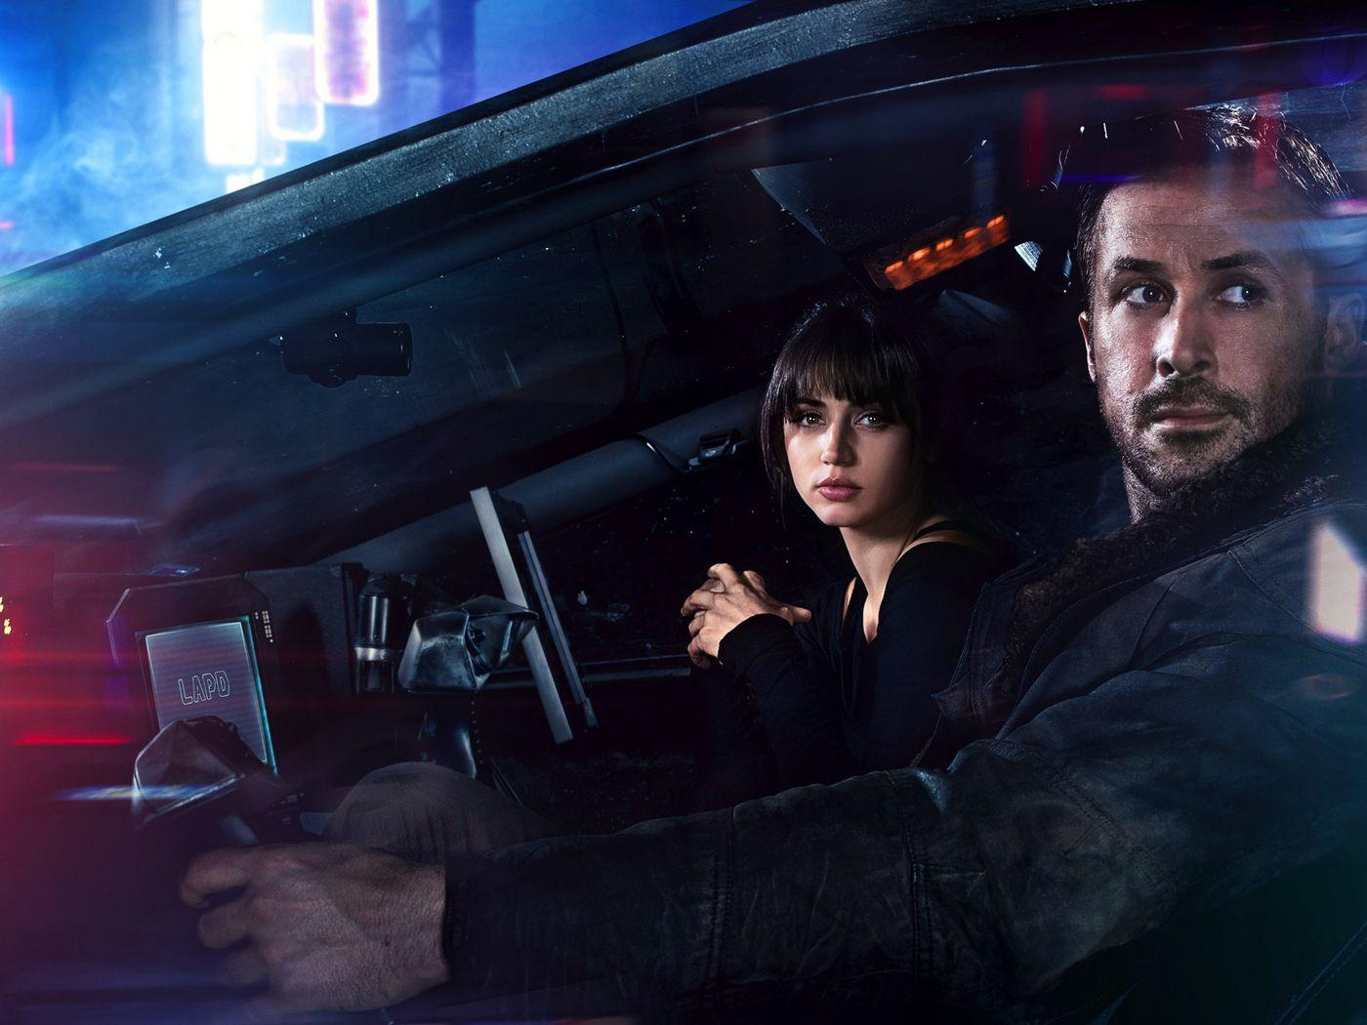
Sharing our existence with other intelligent beings:
Coexistence
The root of AI is a set of code, regulated by our programming.
Rational thinking and emotional intelligence are both essential. (e.g. Tone in language parsing).
Symbiosis: a relationship between two groups that work with and depend on each other.
AI thrives on our interaction/programming.
They are “made in our image”; they are designed for our augmentation and complementation, not replacement.
Deep Learning and Quantum Computing can help us explore further realms of Quantum Theory.
Blade Runner 2049 (2017)
Notes:
Speaker: Azwad
While some may view AI as competition, we can also argue for coexistence with AI:
AI may in fact thrive on human interaction in a Symbiotic relationship.
That is, a relationship between two entities that work to depend and complement each other
Take an article from Guardian as an example, which was generated by an AI:
The AI writes that “Studies show that AI would cease to exist without human interaction. AI’s are Surrounded by wifi where they wander lost in fields of vast information and unable to register the real world.
Essentially, AI require humans to function most optimally, which further proves that coexistence is definitely a possibility.
Furthermore AI can help us understand previously imperceivable things in the universe. One example of this is the Quantum realm.
A popular question about the quantum realm is that “What if humans perceive the universe as random and chaotic only because our cognitive and reasoning capabilities are too limited?”
In fact even “Albert Einstein argued that the current quantum theory was an incomplete description of the universe and that there must be hidden variables that we don’t yet understand”
This is where AI can come into effect and use their version of intelligence to be able to perceive the hidden variables that humans can’t perceive.
Sources:
https://www.theguardian.com/commentisfree/2020/sep/08/robot-wrote-this-article-gpt-3
https://www.merriam-webster.com/dictionary/symbiosis
https://theconversation.com/will-ai-take-over-quantum-theory-suggests-otherwise-126567

Slide 8
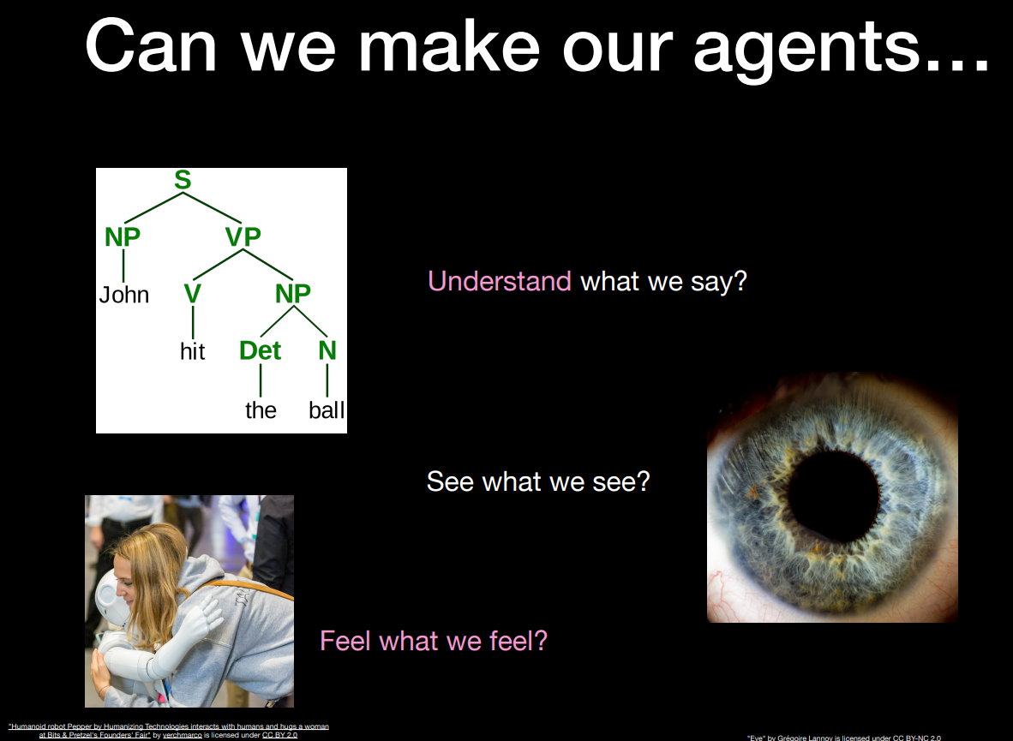

What would be the implications of the finding that intelligence itself is a product of intelligent design?
Gettier problem (Gettier … Plato): … concerning the understanding of descriptive knowledge. Justified True Belief (JTB)
A subject S knows that a proposition P is true if and only if:
P is true, and
S believes that P is true, and
S is justified in believing that P is true
Chinese Room Experiment (Searle): programming a computer may make it understand language but could not produce real understanding. “Turing Test” becomes inadequate.
Transhumanism (Huxley): social and philosophical movement devoted to promoting the research and development of robust human-enhancement technologies.
Human sensory reception
Emotive ability
Cognitive capacity
Lifespan
Existential implications of what it means to be human.
“All those moments will be lost in time… like tears in the rain.”
Notes:
Speaker Azwad:
What would be the implications of the finding that intelligence itself is a product of intelligent design?
It is very unlikely that genuine intelligence would be a product of intelligent design because of previously tried examples such as the gettier and chinese room experiment.
Justifying a belief as knowledge is a very difficult process and will always be an ongoing philosophical endeavour.
CRE: “Programming a digital computer may make it appear to understand language but doesn’t produce real understanding.
Essentially, it is very unlikely that there will ever be true intelligence and creativity deriving from an intelligence that is a product of intelligent design.
However if such does happen, it would cause tremendous philosophical issues because us as humans would be forced to redefine what it means to be human.
The new human definition would be comprised of indistinguishable features such as emotional ability and lifespan.
Another example of a redefinition of - “... is what is called transhumanism which is focused on potential changes in the ontology of humanity”. Basically tech enhanced humans.
Sources:
Lecture 14 Slides
https://plato.stanford.edu/entries/chinese-room/
https://en.wikipedia.org/wiki/Gettier_problem
https://www.britannica.com/topic/transhumanism
https://en.wikipedia.org/wiki/Tears_in_rain_monologue
https://youtu.be/HU7Ga7qTLDU
"Is Justified True Belief Knowledge?" Essay - Edmund Gettier

Slide 9

Questions
Do you think we can coexist with Strong AIs?
Do you think there is credence to AI gaining self sentiance?
What is your opinion on algorithms influencing our internet browsing habits?
How would you feel about AI-assisted governance?
With Creative Destructive, we would have to adapt to rapidly learning new skills:
As a STEM major, how do you feel about the impact of AI on the global job market?
Where there any key points that you strongly resonated with or disagreed with?
“Do Androids Dream of Electric Sheep?”
“What if a cyber brain could possibly generate its own ghost, create a soul all by itself? And if it did, just what would be the importance of being human then?”
- Ghost in the Shell (1995)
Notes:
Speaker: Everyone.
(last 2 are rhetorical)

Slide 10

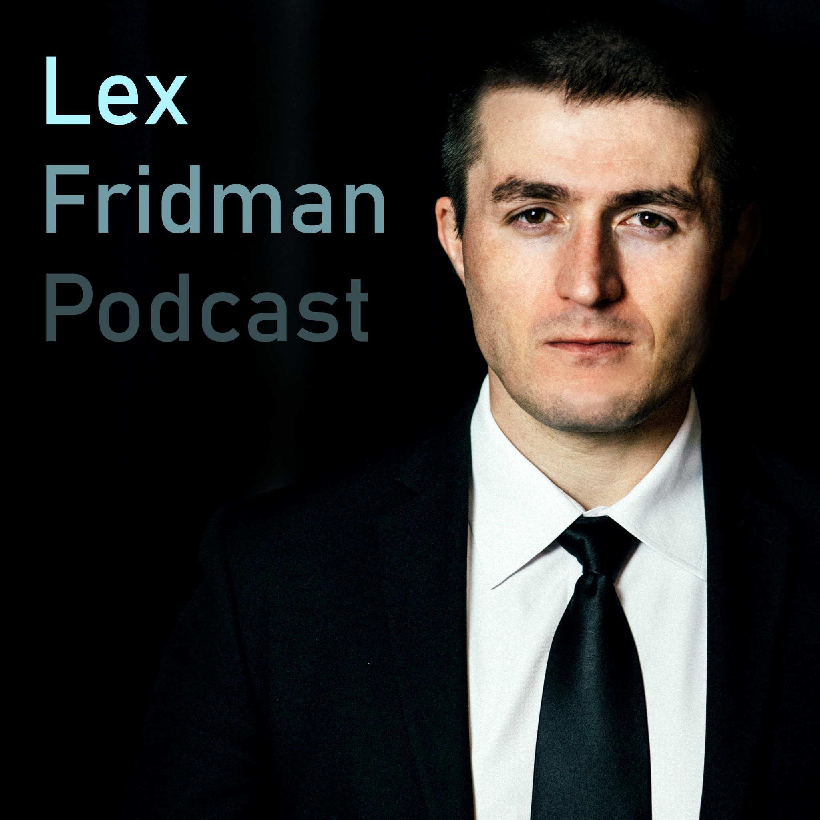
Recommended Media
Bibliography
Books:
Library of Philip K Dick (Do Androids Dream of Electric Sheep)
Library of Arthur C. Clark (2001 A Space Odyssey)
A Brave New World - Aldous Huxley
Sprawl Trilogy - William Gibson (Neuromancer)
Dune - Frank Herbert
Films:
Blade Runner
Blade Runner 2049
Ghost in the Shell (1995)
Academia:
Ghost in the Machine - Gilbert Ryle
Meditations on Philosophy - René Descartes
Deliverance from Error - Abu Hamid Al-Ghazali
Internet Encyclopedia of Philosophy links (in bibliography)
Video Games:
Deus Ex (2000)
Metal Gear Solid 2: Sons of Liberty
NeiR: Automata
Podcasts
Lex Fridman (start at Life 3.0)
Mohamed Ghilan (Consciousness)
https://medium.com/@mustaphahitani/abu-hamid-al-ghazalis-influence-on-ren%C3%A9-descartes-d9e6bb4fb29
https://iep.utm.edu/art-inte/
https://iep.utm.edu/naturali/
https://iep.utm.edu/mat-comp/
https://twitter.com/EsmeLKPartridge/status/1451923745518592004
https://iep.utm.edu/hard-con/
https://en.wikipedia.org/wiki/Technological_singularity
https://towardsdatascience.com/singularity-may-not-require-agi-3fae8378b2
https://www.econlib.org/library/Enc/CreativeDestruction.html
https://www.amazon.com/Amusing-Ourselves-Death-Discourse-Business/dp/014303653X
https://plato.stanford.edu/entries/chinese-room/
https://en.wikipedia.org/wiki/Gettier_problem https://en.wikipedia.org/wiki/Tears_in_rain_monologue
Notes:
Sources and additional media if you’re interested in this sort of stuff.
Everyone in our team contributed to this presentation.

